Slide 1
Step 15 - Docker

Slide 2
What is Docker
A container is a standard unit of software that packages up code and all its dependencies so the application runs quickly and reliably from one computing environment to another.
A Docker container image is a lightweight, standalone, executable package of software that includes everything needed to run an application: code, runtime, system tools, system libraries and settings.
Container images become containers at runtime and in the case of Docker containers – images become containers when they run on Docker Engine.

Slide 3
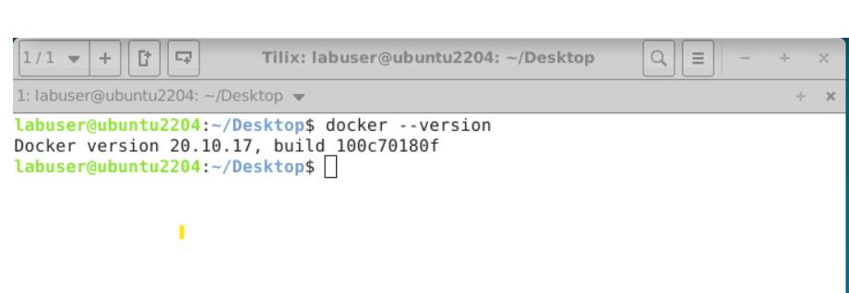
Docker commands
Please login to Virtual Lab.
Open the terminal in Virtual lab.
Check the Docker version using the command as
docker --version

Slide 4
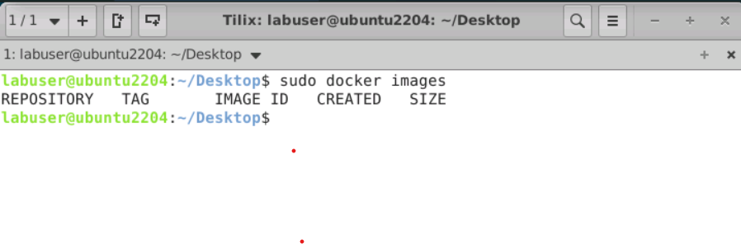
To find running images

Slide 5
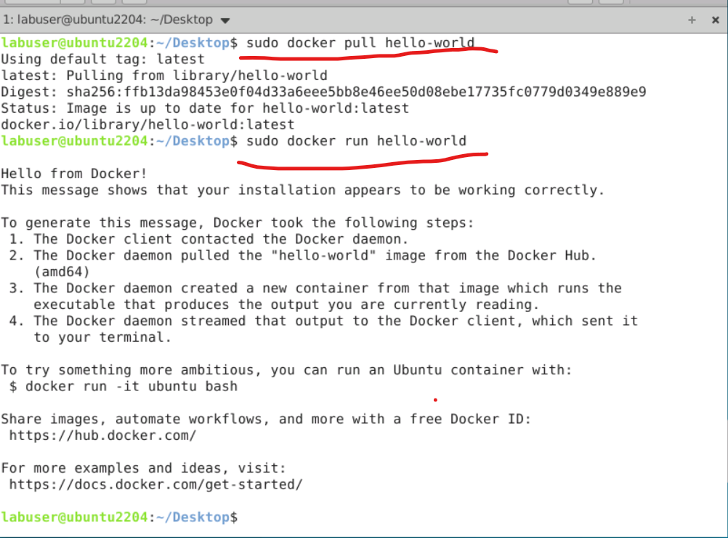
Pull pre defined images and run the image ss

Slide 6
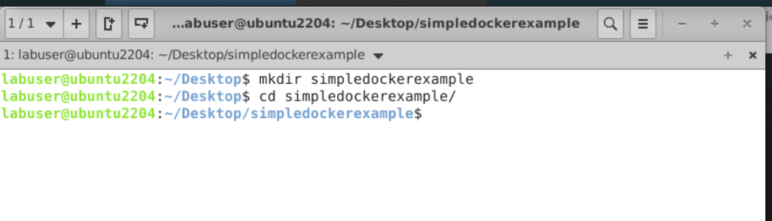
Creating our own image to run simple node js program
First create simple folder and move inside that folder

Slide 7
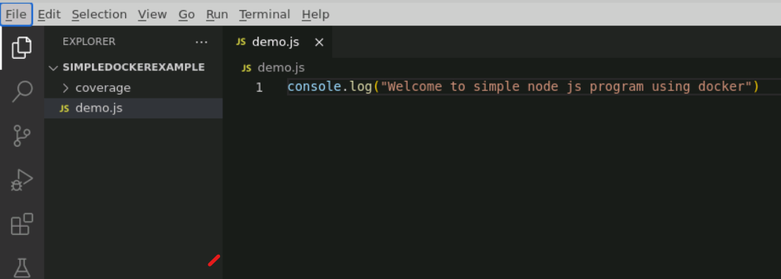
Open that folder in vscode

Slide 8
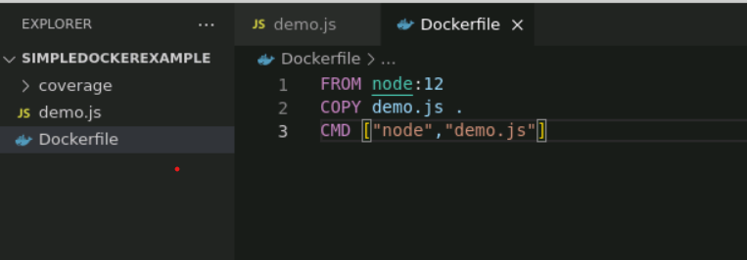
Now create Dockerfile

Slide 9
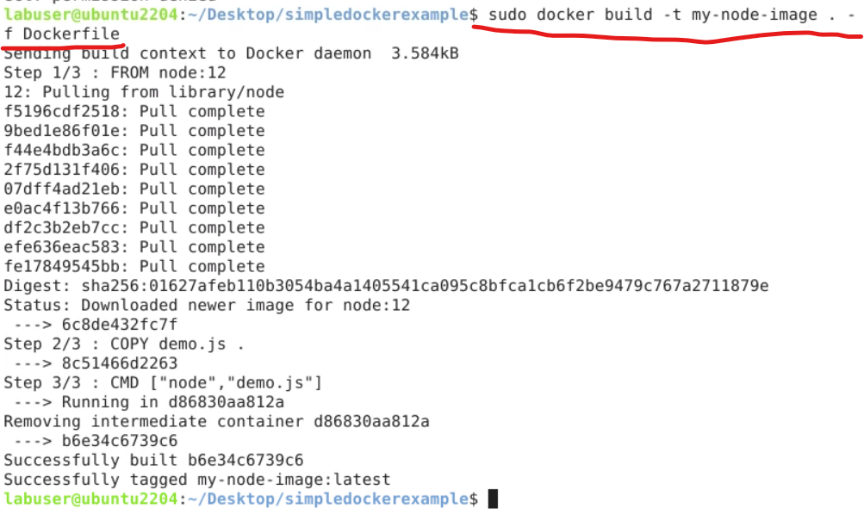
Now build the image

Slide 10
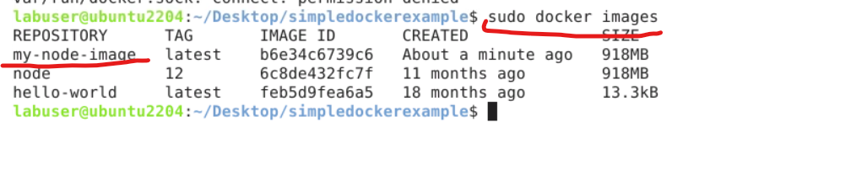
Now we can view our images

Slide 11
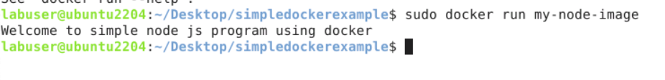
We run our image

Slide 12
Docker compose
If you want to run more than one container those container run independently or depends upon each others then we need to create Docker compose file and we run these file using docker-compose command.

Slide 13
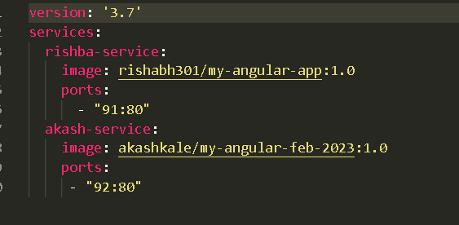
Sample docker compose file

Slide 14
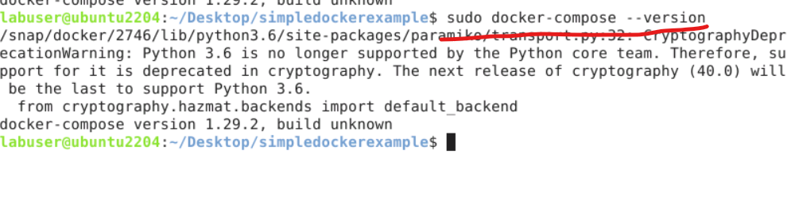
First check docker compose version

Slide 15
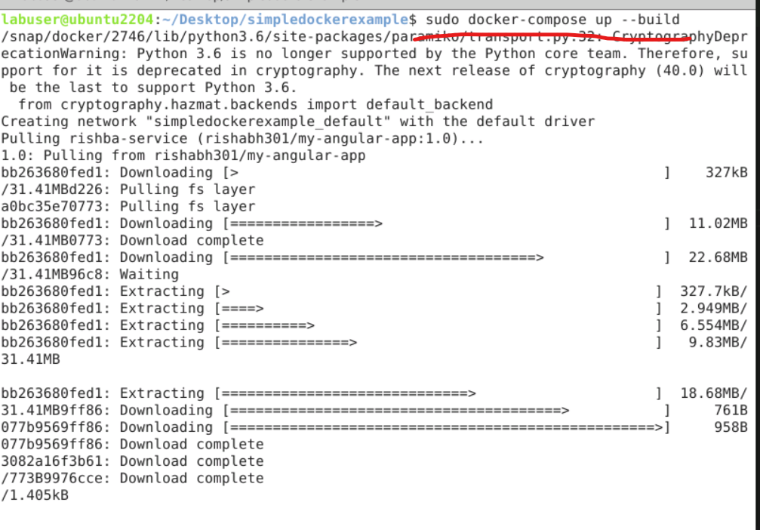
Run docker-compose.yml file using docker-compose command

Slide 16
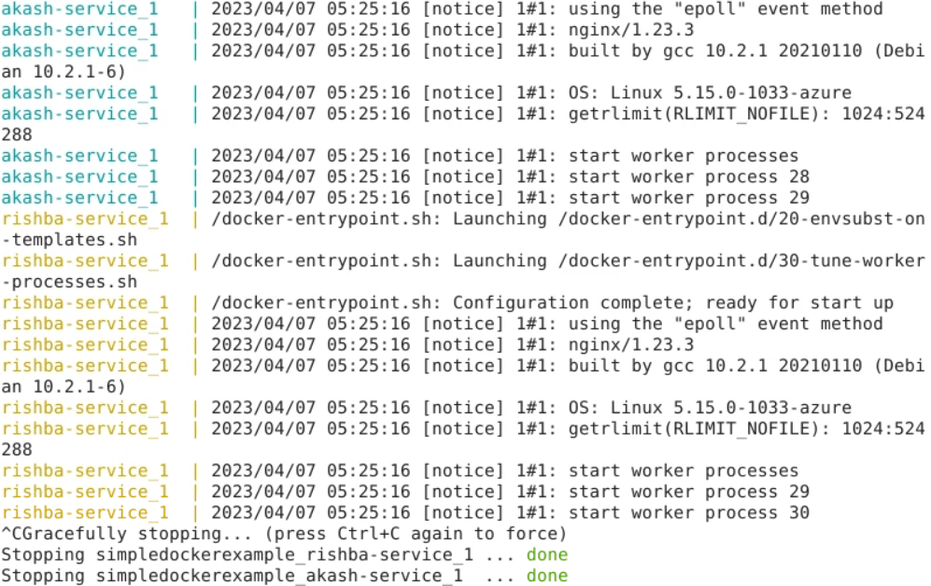
Here both containers up

Slide 17
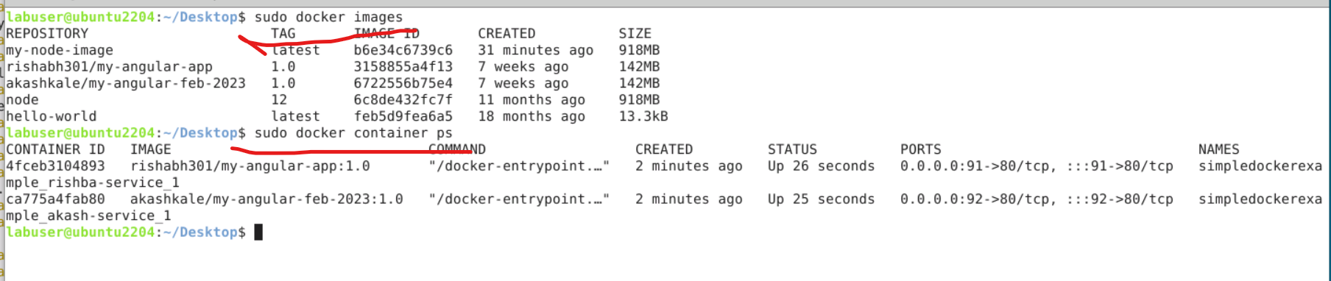
To check those container and images details we need to open another terminal

